Slide 1
Hamiltonian Monte Carlo
Toby Nixon

Slide 2
Motivation
In high dimensions, many sampling methods struggle to effectively navigate the target distribution.
If out in the tails, Metropolis-Hastings proposals will struggle to sample from back within the typical set, causing the chain to get “stuck”.
An extremely low acceptance rate will follow, and the chain could be biased.
Hamiltonian Monte Carlo is an alternative sampling method which uses Hamiltonian dynamics to make better informed proposals and deal better in high dimensions.
Notes:
MH is very weak as the dimension of the parameter space increases.
Imagine being out in the tail of a 2D distribution. You have virtually no density in any direction save for backwards. Until you sample backwards, you will reject every proposal. Extrapolate to high dimensions, this means you get stuck.
The chain becomes biased.
We need a method of proposing new samples that are more likely to be accepted. This requires a sampler that knows how to return to the typical set from the tails.

Slide 3
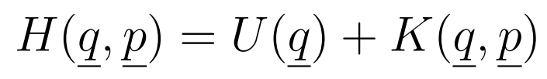
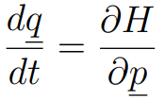
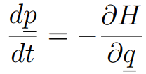
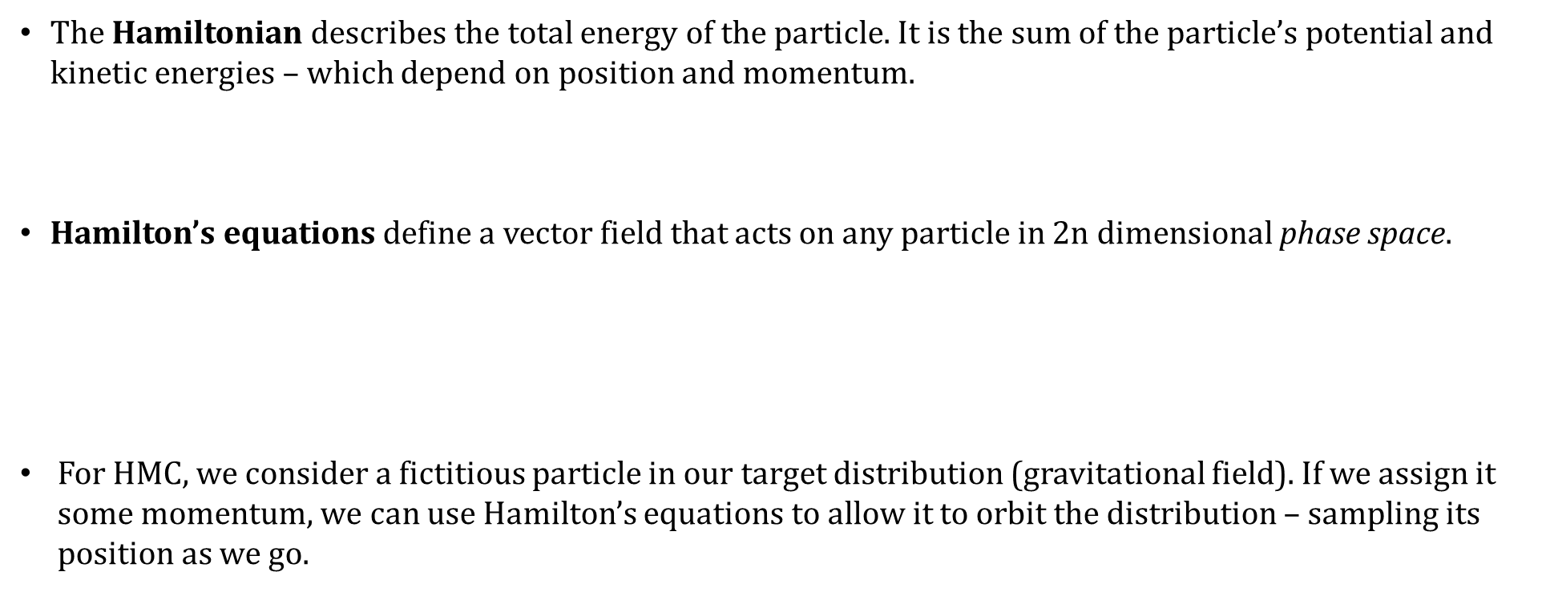
Hamiltonian Dynamics
Hamiltonian dynamics is a reformulation of classical Newtonian dynamics and can be used to describe the motion of a particle.
The Hamiltonian describes the total energy of the particle. It is the sum of the particle’s potential and kinetic energies – which depend on position and momentum.
Hamilton’s equations define a vector field that acts on any particle in 2n dimensional phase space$.$
For HMC, we consider a fictitious particle in our target distribution (gravitational field). If we assign it some momentum, we can use Hamilton’s equations to allow it to orbit the distribution – sampling its position as we go.
Notes:
A method of achieving this is by using Hamiltonian dynamics.
Hamiltonian dynamics is a reformulation of Newtonian dynamics (F = ma, etc) which centres on the energy of a system.
In HD, a system is described as having a Hamiltonian function, H, which is the total energy of the system.
It describes a particle or object using canonical parameters, p and q.
Then, Hamilton’s equations can be used to describe the motion of the particle with time, creating a vector field (dim 2n) which will describe the path taken by a particle in any position, with any momentum.
For the purposes of Hamiltonian Monte Carlo, we will use these equations to define a Markov chain, treating the target posterior as a potential field.
It’s important to note that the Hamiltonian has some important properties which will be constantly relied upon: Conservation, reversibility, volume preservation.

Slide 4
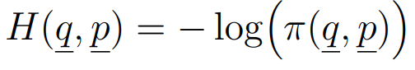
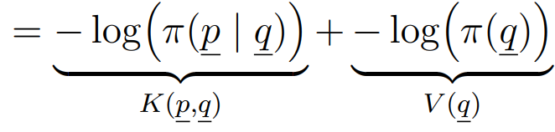
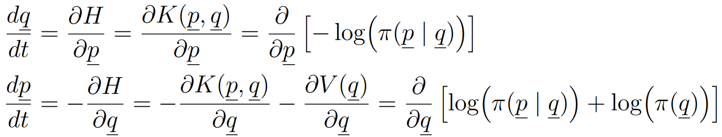
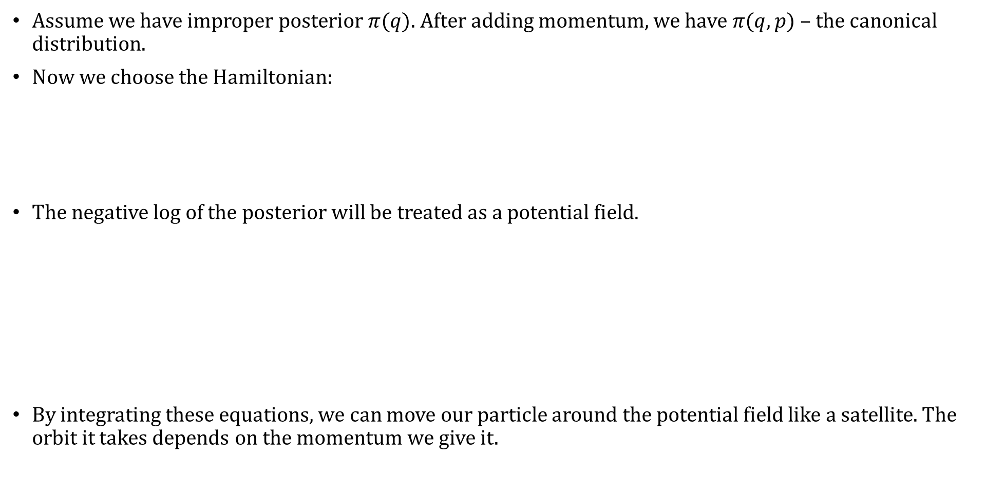
Defining the Hamiltonian
Assume we have improper posterior $π(q)$. After adding momentum, we have $π(q, p)$ – the canonical distribution.
Now we choose the Hamiltonian:
The negative log of the posterior will be treated as a potential field.
By integrating these equations, we can move our particle around the potential field like a satellite. The orbit it takes depends on the momentum we give it.
Notes:
Assume that we have an improper posterior pi(q) that we want to sample from. After adding momentum, we have the canonical distribution.
Now we have to choose the Hamiltonian. [Explain choice]
Now we can define a vector that applies to any point in phase space and directs towards the orbit where the Hamiltonian is conserved.

Slide 5
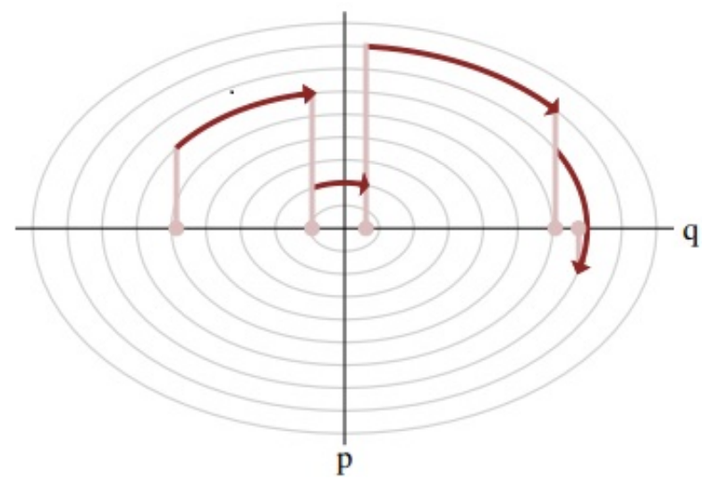


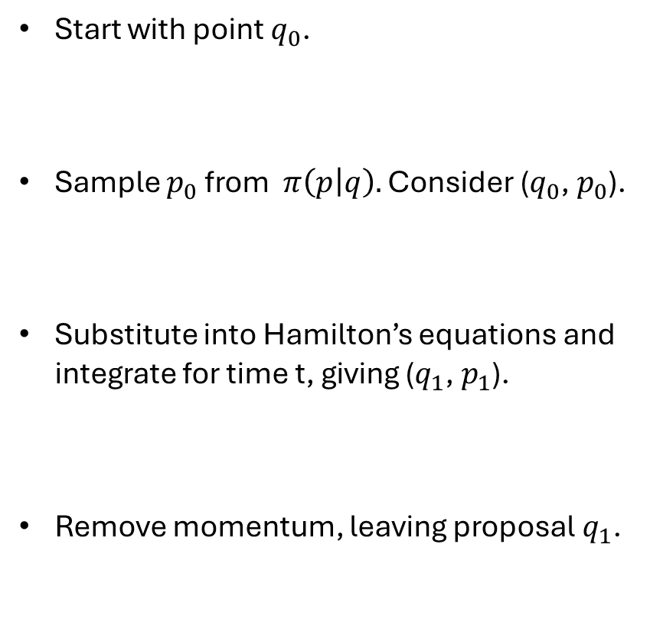
Hamiltonian Markov Transition
Start with point $q_{0}$.
Sample $p_{0}$ from $π\left(p | q\right).$ Consider ($q_{0}$, $p_{0}$).
Substitute into Hamilton’s equations and integrate for time t, giving ($q_{1}$, $p_{1}$).
Remove momentum, leaving proposal $q_{1}$.
$${(q}_{1},p_{1})$$
$${(q}_{o},p_{o})$$
Notes:
We want to construct a method of informing transitions for a Hamiltonian Markov chain.
Assume an initial point in parameter space. We will map this to phase space by randomly sampling a momentum from some proposal distribution (momentum distribution) where our vector field can be readily calculated using Hamilton’s equations.
From there, we can follow the vector field for some time, t, and end up at a new point.
Mapping this back to parameter space, we obtain a new sample.
[Describe figure].

Slide 6

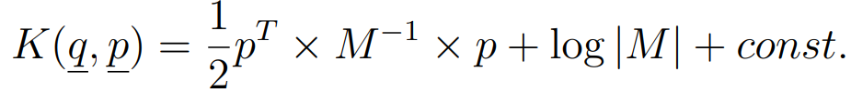

Choosing a Distribution for Momentum
Typically, Euclidian HMC is used. A multivariate normal distribution is assigned, with a fixed covariance matrix, M.
This defines a Euclidian-Gaussian kinetic energy:
Ideally, M is the inverse of the covariance matrix for the target distribution.
Notes:
Naturally, we are going to need a distribution to sample the momenta from.
This will be something we choose ourselves – like a proposal. There are two options that are most common:
[Describe EHMC]
[Describe RHMC]
Choosing between the two is a complexity vs accuracy trade-off.

Slide 7
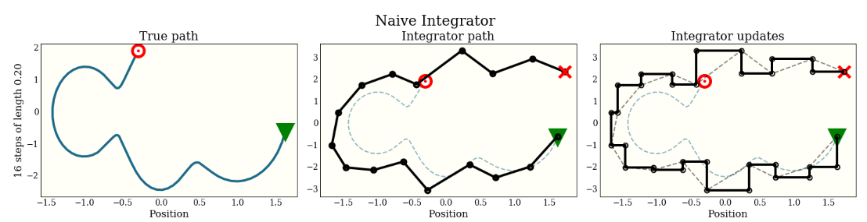

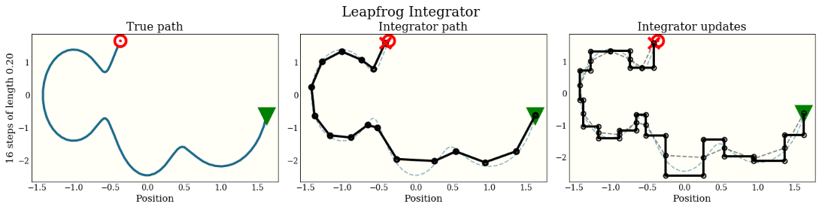



The Integration Step
Choose a t that optimises exploration of the target distribution. Too small will slow the chain down significantly; too large will harm efficiency.
We must use symplectic integrators – e.g. the leapfrog method.
Initialise: Start with position ${(q}_{0},p_{0}).$
Update momentum (half-step):
Update position (full-step):
Update momentum (half-step):
(Colin Carroll, 2019)
Notes:
Additionally, the ideal method described required the choice of a set integration time, t. It is important to choose t wisely. Too large will not explore efficiently.
In order to conduct the integration, typical integrators – Euler’s, Runge Cutta, etc – cannot be used. They violate properties of Hamiltonian dynamics that must be preserved when integrating Hamilton’s equations. [Describe volume preservation].
We must use symplectic integrators instead, which work slightly differently as to adhere to the principles of Hamiltonian dynamics. They are not so complicated as you might think. For example, we will refer entirely to the leapfrog method, which will break a chosen integration time, t, into steps of a smaller length, call this step-size epsilon.
[Describe the steps].
Thus, we end up with a new position along the same iso-Hamiltonian line.
[Brief discussion of the difference between integrators via figure].

Slide 8
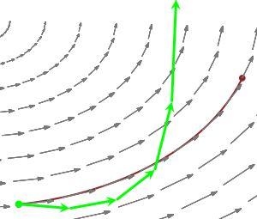
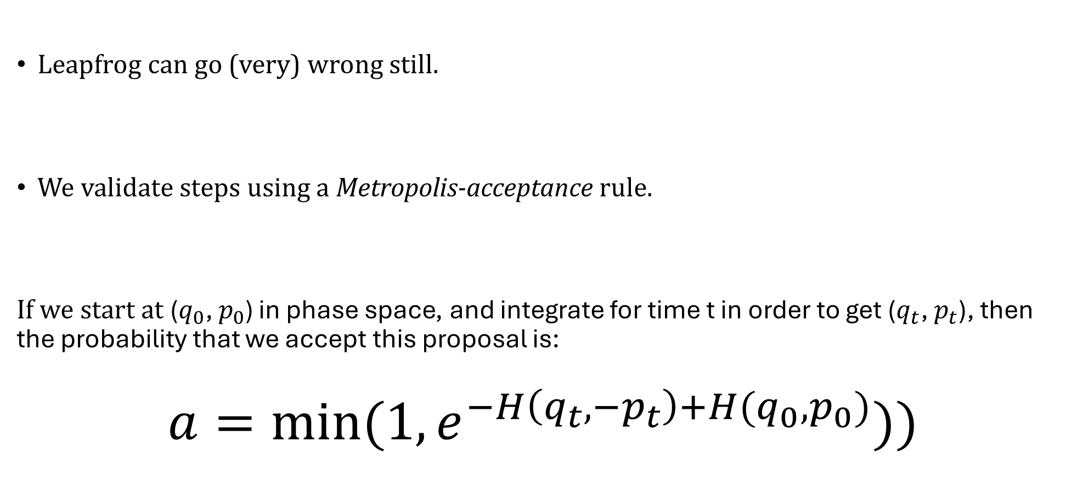
Correcting for Numerical Errors
Leapfrog can go (very) wrong still.
We validate steps using a Metropolis-acceptance rule.
If we start at ($q_{0}$, $p_{0}$) in phase space, and integrate for time t in order to get ($q_{t}$, $p_{t}$), then the probability that we accept this proposal is:
$$a=min⁡(1, e^{−H\left(q_{t}, −p_{t}\right)+H(q_{0},p_{0})}))$$
Notes:
The leapfrog integrator does have its own numerical errors. Indeed, if the curvature is particularly strong, the leapfrog algorithm can break and send a trajectory flying into phase space.
So, we need a Metropolis acceptance step in order to account for these issues.
As for MH, the usual method of calculating the acceptance rate includes the division of the probability of proposing the old point, given you have the new point, by the probability that you propose the new point, given you have the old point. Due to the deterministic nature of the integration step, the former will always be 0. As a result, we have to augment the momentum in order to make it non-zero and give the acceptance probability meaning.
We can do this by switching the sign on the momentum.
Now the probability of proposing the initial point, given the augmented point, is equal to the reverse, and we have cancellation.

Slide 9
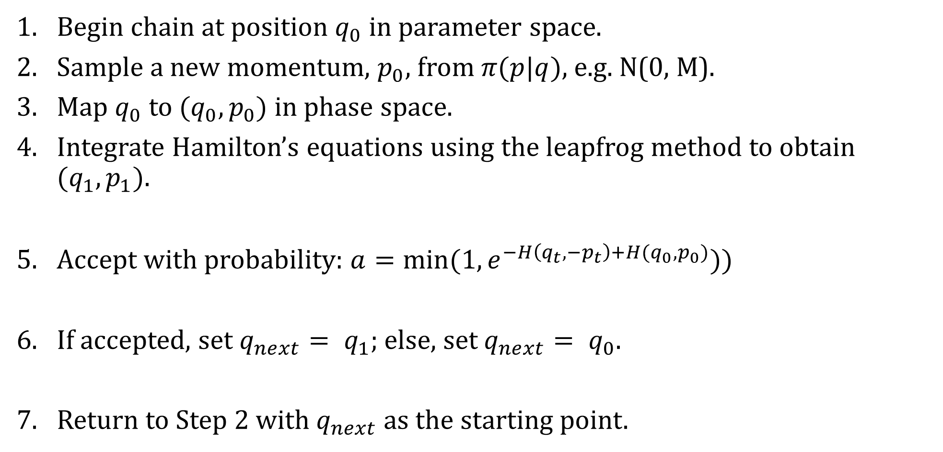
Implementation – The HMC Algorithm
Begin chain at position $q_{0}$ in parameter space.
Sample a new momentum, $p_{0}$, from $π(p|q)$, e.g. N(0, M).
Map $q_{0}$ to ${(q}_{0},p_{0})$ in phase space.
Integrate Hamilton’s equations using the leapfrog method to obtain ${(q}_{1},p_{1}).$
Accept with probability: $a=min⁡(1, e^{−H\left(q_{t}, −p_{t}\right)+H(q_{0},p_{0})}))$
If accepted, set $q_{next}= q_{1}$; else, set $q_{next}= q_{0}$.
Return to Step 2 with $q_{next}$as the starting point.
Notes:
So, take an initial point.
Sample a momentum from the momentum distribution (chosen already).
Map to phase space.
Integrate Hamilton’s equations in order to follow the corresponding level-set or iso-Hamiltonian trajectory.
Now flip the sign on the momentum,
And accept with probability a.
If accepted, we take the proposal as the new point and restart the process. If not, we resample the initial point and begin again.

Slide 10
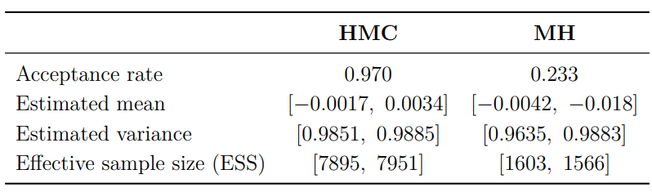



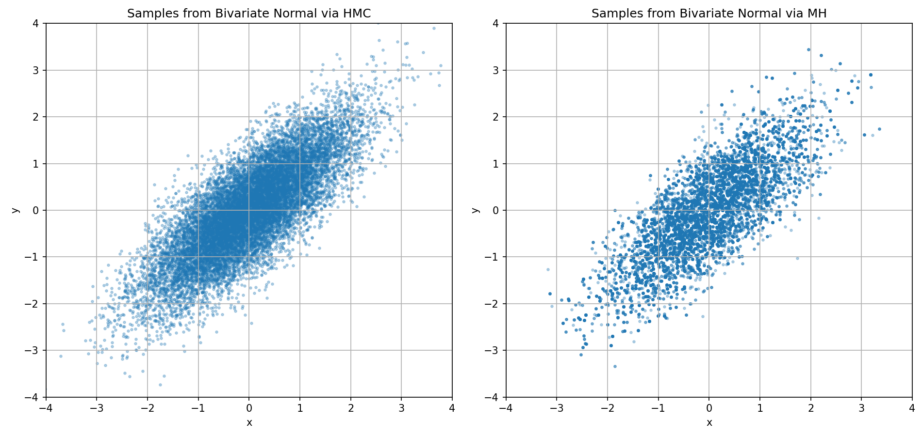
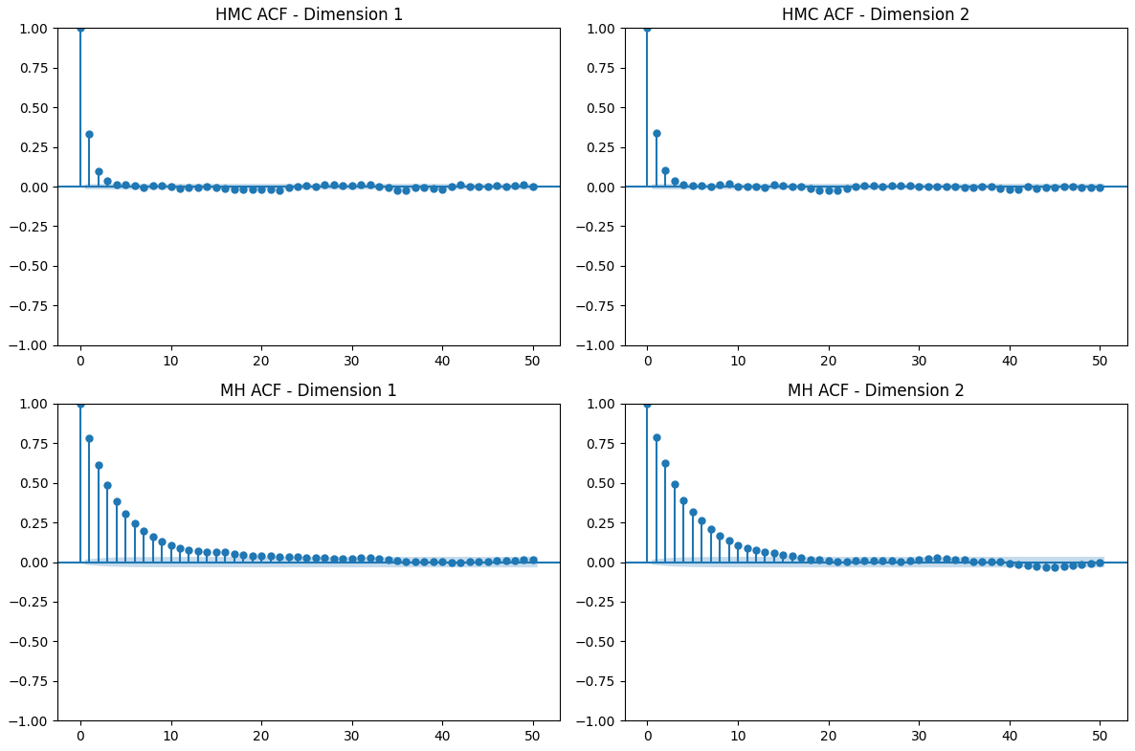
Simple Comparison with Metropolis-Hastings
Attempt to sample from:
Initial point: (0,0) for both.
Samples: 20,000; burn-in: 5,000.
MH proposal: , k = 5.7.
HMC:
Integration time 5.0, step-size 0.5.

Slide 11
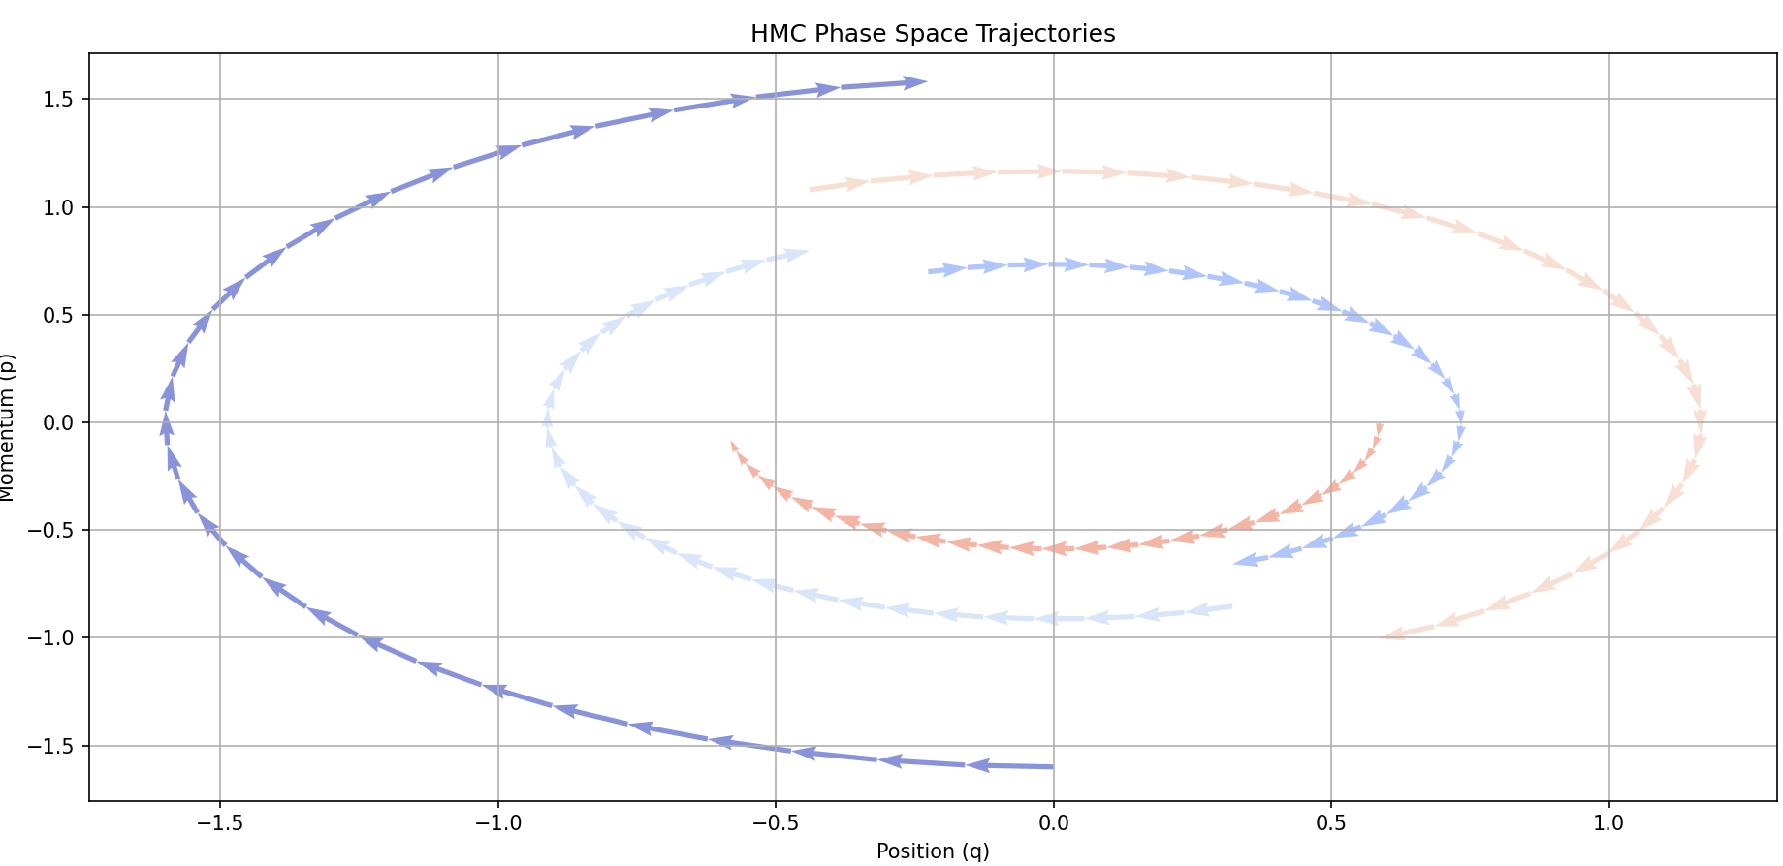
Thanks for Listening

